Slide 1
Digital Portfolio
STUDENT NAME: Dhinesh Raj.K
REGISTER NO AND NMID: 48CB286F0469E9284354EC3926A447C8/
212402346
DEPARTMENT: BCA
COLLEGE: Agurchand Manmull Jain College
UNIVERSITY: Madras university

Slide 2
PROJECT TITLE
Digital Portfolio

Slide 3


AGENDA
Problem Statement
Project Overview
End Users
Tools and Technologies
Portfolio design and Layout
Features and Functionality
Results and Screenshots
Conclusion
Github Link
3/21/2024 Annual Review

Slide 4

PROBLEM STATEMENT
Many aspiring developers lack a personal digital portfolio to showcase their skills, achievements, and projects in a professional manner. This creates challenges when applying for internships or freelance opportunities.

Slide 5

PROJECT OVERVIEW
This project is a modern, responsive portfolio website designed for Dhinesh Raj K. It highlights his skills, education, certificates, and contact details. The portfolio is structured to provide a clean, accessible, and engaging user experience.

Slide 6

WHO ARE THE END USERS?
- Recruiters looking for web development talent
- College professors evaluating student progress
- Clients seeking freelance developers
- Networking contacts and peers in the tech community

Slide 7

TOOLS AND TECHNIQUES
- HTML
- CSS
- Responsive design principles
- GitHub for version control , hosting and VScode

Slide 8
POTFOLIO DESIGN AND LAYOUT
- Dark-themed modern design
- About section with bio and photo
- Skills section with progress bars
- Certificates and achievements
- Contact form with email and phone details
- Downloadable CV option
8

Slide 9
FEATURES AND FUNCTIONALITY
- Responsive layout for mobile and desktop
- Interactive skill progress bars
- Sections: About, Services, Skills, Certificates, Contact
- Easy navigation with clean UI
- Download CV button for recruiters

Slide 10
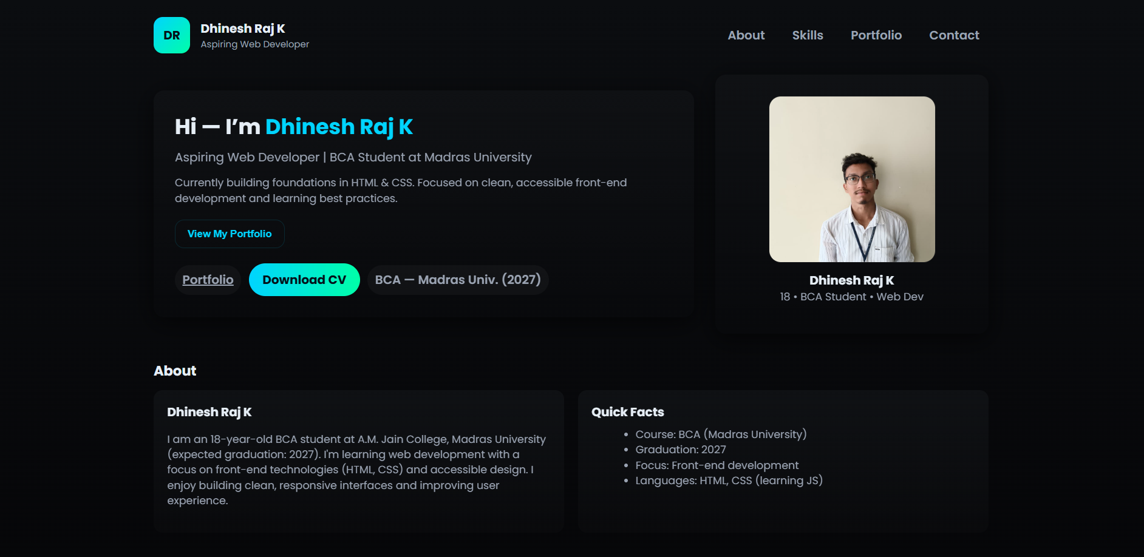

RESULTS AND SCREENSHOTS
The portfolio website successfully showcases Dhinesh Raj K's skills, education, and certifications. Screenshots include:
- Home Page
- About Section
- Skills and Certificates
- Contact Page
3/21/2024 Annual Review
10

Slide 11
CONCLUSION
The portfolio website provides a professional online presence for Dhinesh Raj K. It demonstrates his skills in web development, enhances his visibility, and serves as a valuable tool for career opportunities.
11

Slide 12
GITHUB LINK:
https://github.com/24h027-a11y/portfolio.git

